Slide 1
Role-based Domain Architecture
Erik Eidt, Mathias Salle
EDS CTO Office and hp OS&T
2.51
Copyright (c) 2009-2012 Hewlett-Packard Development Company, L.P.

Slide 2
Role-based Domain Architecture Introduction
What is our definition of the purpose of methodology?
To facilitate the decomposition and analysis of a problem space
To facilitate the expression, capture, analysis, sharing, and leverage of architectural solutions
When is the RDA methodology applicable?
Appropriate for complex domains or ecosystems especially those that cross business boundaries
Appropriate for architecting above the level of point applications
e.g. for Cloud
and the new business opportunities cloud can enable

Slide 3
Role-based Domain Architecture Background
Many of these concepts may be familiar
Bringing them together for the purpose of cloud
Formalize terms and techniques
Common ground & terminology

Slide 4
Role-based Domain Architecture Introduction
The Methodology instructs on the capture of
Context using Roles, Responsibilities & Artifacts
Services using Prescriptive Architecture
Designs using Services and Information Models
Implementations using standards and components
And mappings between these
Eventually leading to the capture of repeatable archetypical patterns in each of these areas

Slide 5
Role-based Domain Architecture Introduction
What are the inputs & outputs for a methodology?
Start with decomposition and analysis of a domain
Leading to a prescriptive architecture of services
Going to designs for those services & information models
And implementations of those services

Slide 6
Role-based Domain Architecture Benefits
Experiences show faster implementation
Despite initial effort involved in front-end of architectural activities
Over time: higher leverage, reuse, communication, and analysis of:
Domain decompositions
System Architectures
Service Designs
Service Implementations
Mapping of architectural artifacts to implementation

Slide 7
Role-based Domain Architecture Key Concepts
#1: The 4 layer architectural capture
Roles & Responsibilities articulated at the top layer
Layers are related and map to each other
(note: service implementation is beyond the 4th layer)
#2: Recasting domains
A major brain shift for many
The purpose of which is to
Increase automation & efficiency for customers (domain users)
Increase leverage for us (architects, designers, implementers)

Slide 8
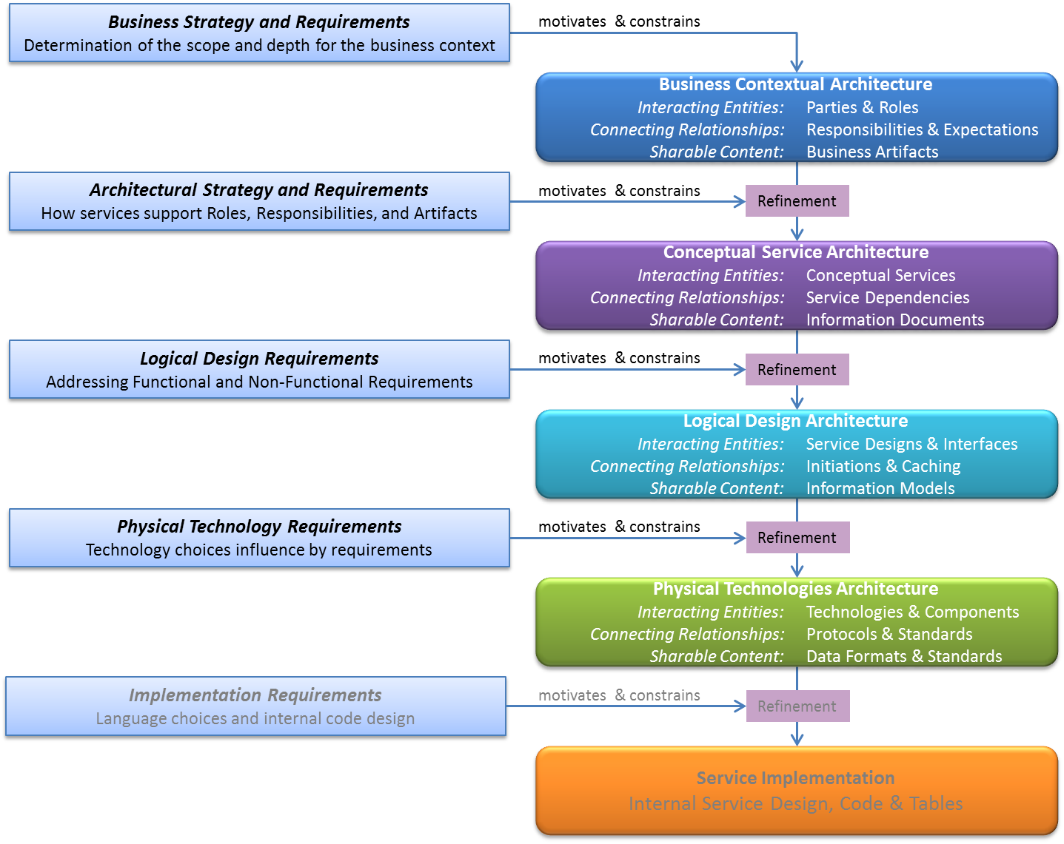
RDA Methodology Layers of Architectural Description
RDA

Slide 9
RDA Methodology Business Contextual Layer
Business Context is the breakdown and analysis of the domain of interest
Based on roles, responsibilities, and artifacts
It is free of any details of underlying implementation
Identify the players at business level
Examine the responsibilities they must carry out
And are expected of them by the others
Discover the artifacts involved in those responsibilities
Also articulates of domain or ecosystem of interest

Slide 10
Role-based Domain Architecture Conceptual Service Layer
Conceptual Service Architecture is
An Architecture of Services and Information Models that support those roles, responsibilities, and artifacts
Using Prescriptive Architecture
The services specified in the architecture are required
Delegation is required by the architecture
Services are a unit of replacement,
Each service is individually replaceable with an alternate design and implementation during refinement at subsequent layers
Headroom for future maturity of service implementations
Latitude allows each service to have individual maturity level
Some rich
Some very primitive – just place holders, at least initially

Slide 11
Role-based Domain Architecture Logical Layer
Designs that accommodate
Functional and Non-functional requirements
Archetypes
E.g. Various kinds of Tiering for computational nodes
E.g. Various kinds of Sharding for storage

Slide 12
Role-based Domain Architecture Logical Design Layer
Designs for services interfaces
Designs for service operations
decide which service initiates communications
Designs for information models
Designs that accommodate
Functional Requirements
Non-functional requirements
Expected load or scale
Archetypes

Slide 13
Role-based Domain Architecture Brain Shift – Recasting Domains
From Process Oriented to Service Oriented
as the basis for abstraction
From Complex APIs to Simple APIs
CRUD + IE
From Build-to-Order to Configure-to-Order
Stratified entry points
Design capture through models
From Application Integration to Ecosystem Architecture
From integrating applications to architecting domain solutions
From building platforms to architecting domain solutions

Slide 14
Role-based Domain Architecture Overview
End

Slide 15
Role-based Domain Architecture Contextual Architecture
Articulate Domain or Ecosystem of interest
Articulate Roles
Articulate Responsibilities
Articulate Artifacts
Articulate Delegations & Expectations

Slide 16
Role-based Domain Architecture Contextual Architecture Considerations
Roles
Can be actors
Can be abstract entities that will be played by actors
An actor can play multiple roles
A role can be generic, reused between architectures

Slide 17
Role-based Domain Architecture Contextual Architecture Considerations
Responsibilities
Can be broken down by consumption, generation of artifacts, processing, by further delegation

Slide 18
Role-based Domain Architecture BCA Artifact Considerations
Artifacts can be
Real world items
Information items: content
Such as documents, forms, or records
Some of portions of which reference real world items
Messages
Which usually contains some kind of
Request for change, or
Indications of status,
in addition to
containing content
That probably references real world items

